Slide 1


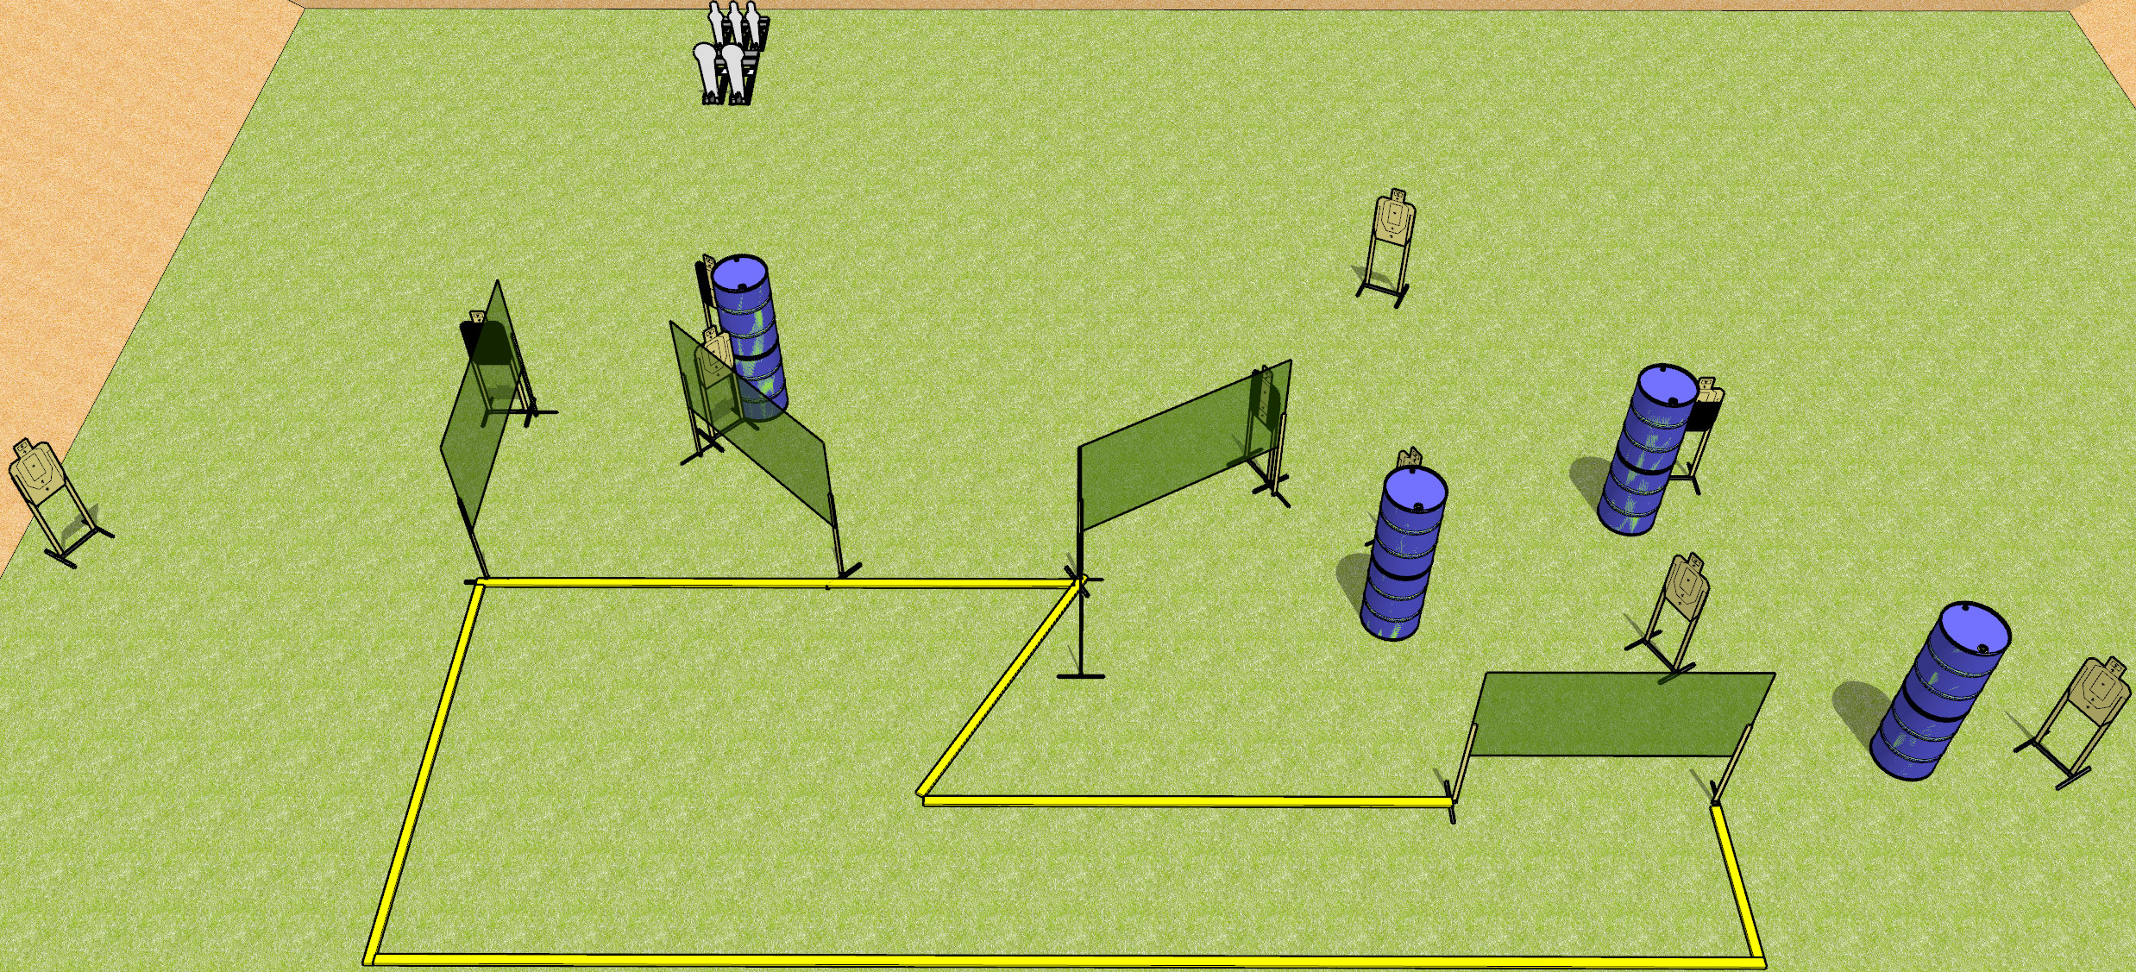
 | Dothan Gun Club – USPSA Match Odd Angles Course Designer : Drew Coleman
START POSITION : Outside the shooting area, heels against frontmost fault line, wrists below belt
GUN READY CONDITION : Pistol loaded and holstered. PCC loaded, held with both hands, buttstock on belt, safety on. |  | SCORING: Comstock, 25 rounds TARGETS: 10 paper, 5 Steel SCORED HITS: Best 2 on paper, steel until down START-STOP: Audible, last shot RULES:
STAGE PROCEDURE: Engage targets as they become available from within the fault lines.

Slide 2
Odd Angles
Written Stage Briefing
Odd Angles is a 25 round, 125 point, Comstock field course. There are ten USPSA targets, two Colt poppers, and three mini poppers. The best two hits on paper will score, and steel must fall to score. The start signal is audible.
Handgun start position is outside the shooting area, heels against the frontmost fault line. Handgun is loaded and holstered.
PCC start position is outside the shooting area, heels against the frontmost fault line. Loaded carbine is held with both hands, buttstock on belt, safety on.
On start signal, engage targets as they become available from within the shooting area.

